Slide 1
Using Statistical Process Control Charts to Monitor EQA Lab Performance
Moses Matovu
Nov 9, 2017
HuQAS Conference 2017
KICD-Nairobi, Kenya

Slide 2
Presentation Outline
Introduction
Methods
Results
Conclusions
Acknowledgments

Slide 3

Introduction
Kabale Regional Referral Hospital Lab is being fast tracked to international accreditation by 2018.
Evaluation of EQA performance is a requirement for ISO 15189:2012 (Clause 5.6.3.4)

Slide 4

Problem Statement
Review of EQA performance is a challenge.
Continual Improvement for EQA performance is lacking

Slide 5
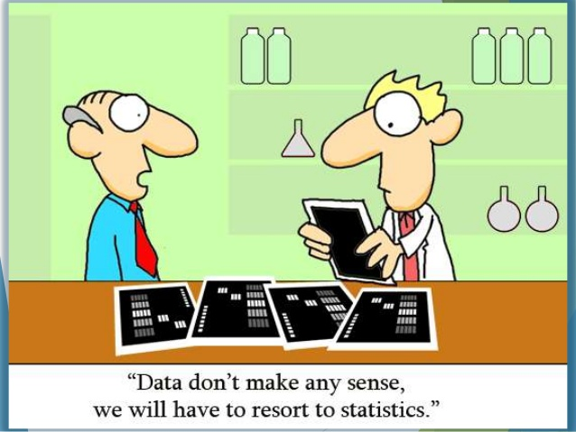

Slide 6
Justification
SPC Charts reveal trends in analytical results that give early warnings of issues or problems that could be developing.
The aim of the study was to apply SPC techniques to monitor EQA performance for UK-NEQAS CD4.

Slide 7
Methods
Reviewed UK-NEQAS CD4 Results: (2015-2016)
Determined Control limits
EWMA charts
Shewhart control charts
Constructed Charts
Monitored performance

Slide 8
Methods

Slide 9
Results

Slide 10
Results

Slide 11
Results

Slide 12
Conclusion and Recommendation
The ability to detect EQA performance variations was improved by using a combination of charts
SPC is a feasible and promising way of monitoring and improving EQA Performance outcomes and should be adopted

Slide 13



Acknowledgments
Participants

